Slide 1
KESOSD : Keyword Search Over Structured Data
Date: 2013/4/1
Author: Jaime I. Lopez-Veyna, Victor J.
Sosa-Sosa, Ivan Lopez-Arevalo
Source: KEYS’12
Advisor: Jia-ling Koh
Speaker: Chen-Yu Huang

Slide 2
Outline
Introduction
Approach : KESOSD
Graph
Tuple Unit
Virtual Document
Ranking
Indexing
Experiments
Conclusion

Slide 3
Introduction
The origin of the information comes from a variety of data sources that could be classified based on its structure:
Unstructured data : plain text
Semi-structured :XML documents , HTML pages
Structured : tables in a relational database

Slide 4
Introduction
Current search engines are mainly focused on exploring unstructured information.
Without having a detailed knowledge of the schema of the database and without the need to learn some formal language like SQL.
Losing relevant information that could be found in different data sources like semi-structured or structured.

Slide 5
Introduction
Propose a novel approach for keyword search over structured data : KESOSD.
To improve the keyword-based search over structured data and make an efficient processing using a score based on the classical Information Retrieval.

Slide 6
Outline
Introduction
Approach : KESOSD
Graph
Tuple Unit
Virtual Document
Ranking
Indexing
Experiments
Conclusion

Slide 7
Query Processing
A database with n table
KSAI
index
Return the top-k answers with the highest scores
Data Graph
Compute the score of each relevant virtual document
Tuple Units
Virtual documents
Virtual document contains K
Given a keyword query K = k1, k2,……kn

Slide 8
Graph
Model structured data as an undirected graph, where nodes are tuples, and the edges are primary-foreign key relationships.
Given a database D with n table.
Ri Rj : Ri has a foreign key k which refers to the primary key of Rj.
k

Slide 9
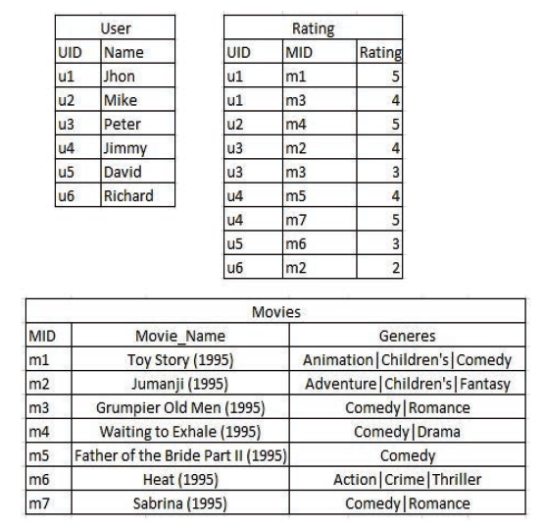
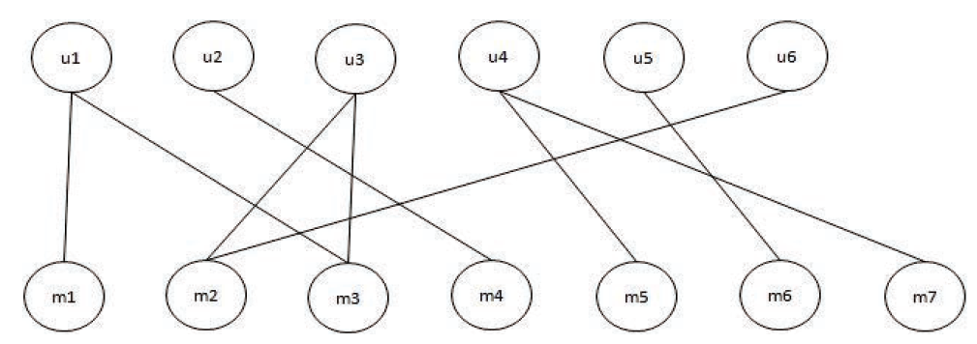
Graph
A relational table Ri is called
a link table.

Slide 10
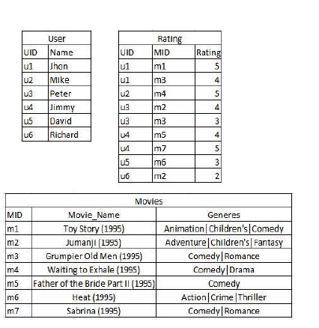
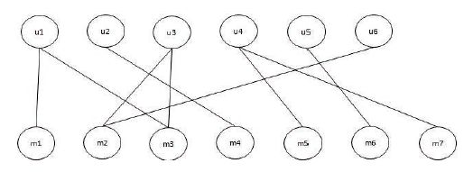
Tuple Units
Choose a root node of the data graph and the set of neighbors or adjacent nodes connected by primary or foreign key, is called a Tuple Unit.

Slide 11
Tuple Units
Choose a root node of the data graph and the set of neighbors or adjacent nodes connected by primary or foreign key, is called a Tuple Unit.

Slide 12
Tuple Units
Choose a root node of the data graph and the set of neighbors or adjacent nodes connected by primary or foreign key, is called a Tuple Unit.

Slide 13
Virtual Document
Create a new document for each neighbor of the node, and all these documents together compose a single Virtual Document.
Ex:

Slide 14
Virtual Document
Create a new document for each neighbor of the node, and all these documents together compose a single Virtual Document.
Ex:

Slide 15
Ranking
The simplest way to score and rank the virtual documents is by the use of the TF·IDF metric.
D : total set of the virtual documents
N different virtual documents
K keywords
Given a virtual document denoted as d є D and a keyword ki contained in d.

Slide 16
Ranking
Normalized term frequency of ki :
tf(ki, d) : the number of occurrences of the term ki in a document d
Ex:
k1 : Children’s ntf( k1 ) = 1 + ln( 1 + tf( k1, d ) ) = 1.6931
K2 : Fantasy ntf( k2 ) = 1 + ln( 1 + tf( k2, d ) ) = 1

Slide 17
Ranking
Inverse document frequency of ki :
dfki : the number of virtual documents that terms ki occurs in D
Ex:
k1 : Children’s idf( k1 ) = ln( 5 / (2+1) ) = 0.5108
K2 : Fantasy idf( k2 ) = ln( 5/ (1+1) ) = 0.9162

Slide 18
Ranking
Document Normalized length:
|d| : the number of terms in a documents D
S : a constant taken from IR literature and is usually set to 0.2
Ex:
d1 : vd (Tu1) ndl( d1 ) = ( 1-0.2 ) + 0.2 * ( 14 / (50/ 5) ) = 1.08
d2 : vd (Tm2) ndl( d2 ) = ( 1-0.2 ) + 0.2 * ( 12 / (50/ 5) ) = 1.04

Slide 19
Ranking
TF·IDF :
Ex:
k1 : Children’s TFIDF( k1 , d1) = (1.6931 / 1.08) * 0.5108 = 0.8007
K2 : Fantasy TFIDF( k2 , d3) = (1 / 1.04) * 0.9162 = 0.8810

Slide 20
Ranking
SCORE :
Ex:
k1 : Children’s Score( k1 , d1) = = 0.8007
K2 : Fantasy Score( k2 , d3) = = 0.8810
K = Children’s Fantasy Score( K , d1) = 0.8007+0.8810= 1.6817

Slide 21
Indexing
Propose a keyword-structure-aware-index : KSAI index.
Similar to the traditional inverted index.
The entries of KSAI are also the keywords.

Slide 22
Outline
Introduction
Approach : KESOSD
Graph
Tuple Unit
Virtual Document
Ranking
Indexing
Experiments
Conclusion

Slide 23
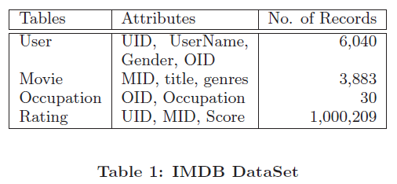
Database
Used the Internet Movie DataBase ( IMDB ) to evaluate.
This dataset generate
1010153 vertex
2006458 arcs
Elapsed time
Build the KSAI : 741 seconds and need 355MB
(includes 4170 keywords without stop words )
Load the index in memory : 108 seconds

Slide 24
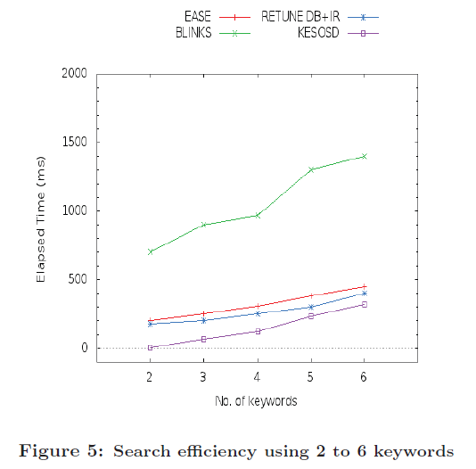
Search efficiency
One hundred queries.
KESOSD :
Not need to use SQL
Not need to discover
the relationship

Slide 25
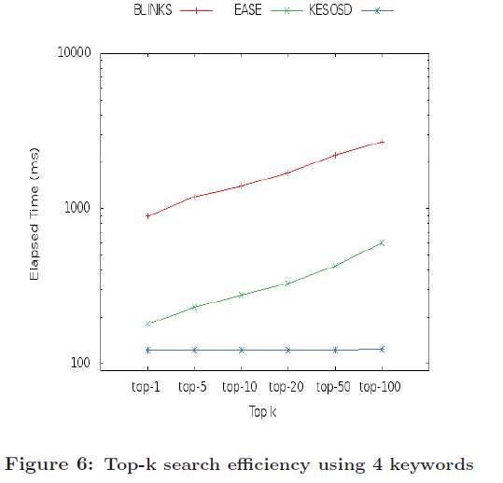
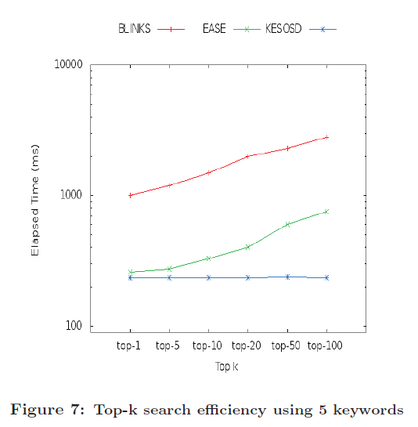
Search efficiency

Slide 26
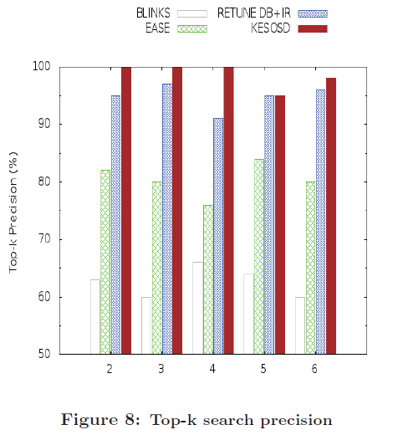
Search accuracy
KESOSD :
Include structural information
in the index construction
Include the TF·IDF

Slide 27
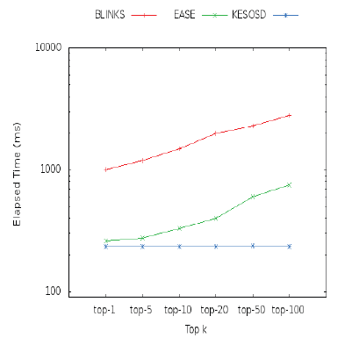
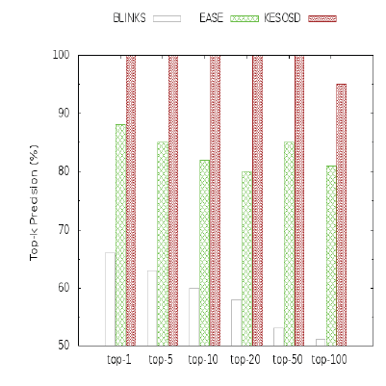
Search efficiency and accuracy

Slide 28
Outline
Introduction
Approach : KESOSD
Graph
Tuple Unit
Virtual Document
Ranking
Indexing
Experiments
Conclusion

Slide 29
Conclusion
KESOSD models structured data as graph and have proposed the use of an data index called KSAI to capture the structural relationships.
KESOSD achieves high search efficiency and quality for keyword search.
Future work includes to continue the testing of KESOSD with other datasets, and continue working some strategies to reduce of the size of the index.

